Slide 1
Statistical Analysis
Introduction to Model Building

Slide 2
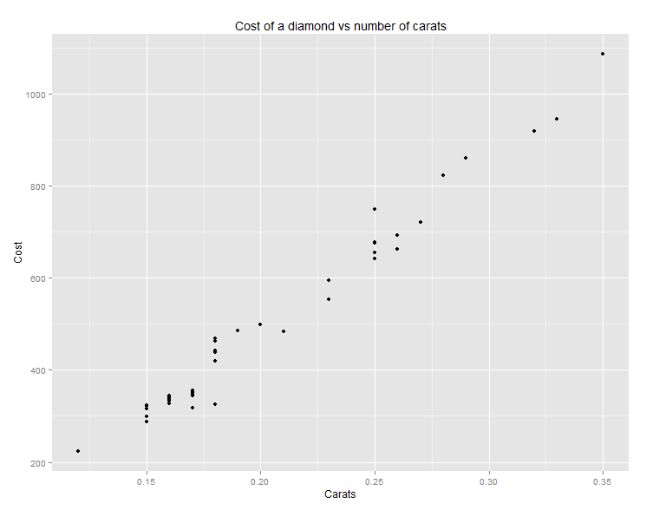
Scatterplot

Slide 3
Models
We often build models to predict something e.g. growth in the economy, whether somebody defaults on a loan, somebody has Multi-media phones.
Predict the cost of a diamond in terms of the number of carats.
Independent variable carat
Outcome/dependent variable price
A sample of diamonds

Slide 4
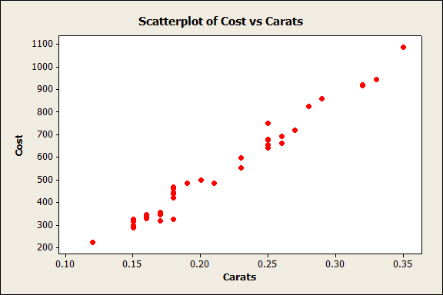

Slide 5
Model
Model - straight line
One dependent variable (outcome)– Cost
One independent variable (input) – number of carats
Cost= α + β * number of carats + residual
where α is the intercept - where the line cuts the Y- axis.
β is the slope of the line
The residual is the part that cannot be accounted for by the model.

Slide 6
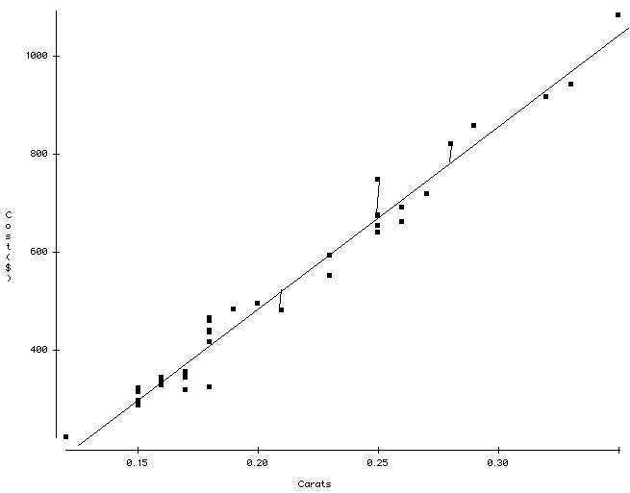
Illustration of residuals

Slide 7
Questions I might ask
How do I calculate values for α and β from my data sample?
How good a model is it?
How could we use the model?
Recall that we only have a sample from a population.
What are the implications of this?

Slide 8
How do we draw the line?
We can draw many lines.
We minimise the sum of the squared residuals
Using this criterion and some fancy calculus we derive estimates for the intercept α and the slope β.
Called Least Squares regression

Slide 9
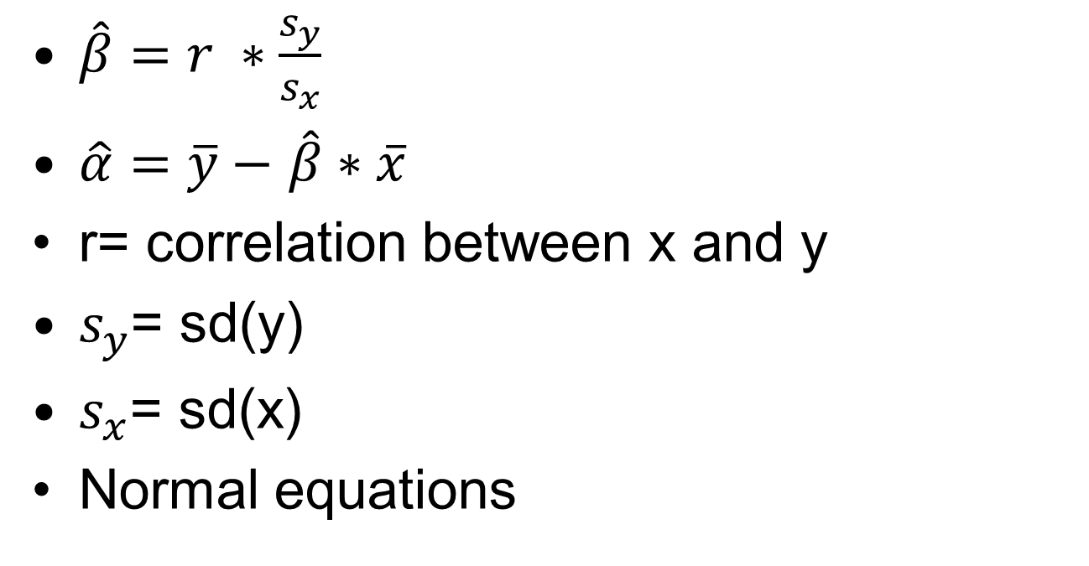
Formulas
$\hat{β}=r ∗\frac{s_{y}}{s_{x}}$
$\hat{α}=\overline{y}−$ $\hat{β}∗\overline{x}$
r= correlation between x and y
$s_{y}$= sd(y)
$s_{x}$= sd(x)
Normal equations

Slide 10
What does this output mean?
Our Model: Cost= α + β * Number of carats+ Error
Cost=-260+3721*Number of carats+Residual
Estimate of α= -260 Estimate of β=3721
-260 = Cost of a diamond with 0 carats (rubbish)
3721 - increase in Y per unit increase in X
Increase number of carats by 1 unit; 1 carat
Cost increase by $ 3721

Slide 11
Part of Regression output from Minitab
Regression Analysis: Cost versus Carats
The regression equation is
Cost = - 260 + 3721 Carats
Predictor | Coef | SE Coef | T | P
Constant | -259.63 | 17.32 | -14.99 | <0.001
Carats | 3721.02 | 81.79 | 45.5 | <0.001
S = 31.8405 R-Sq = 97.8%

Slide 12
Predicted part + residual part
Cost=-260+3721*Number of carats + Residual
Observed Cost= Predicted part + Residual Part
1 case Number of carats= 0.25 Cost = $675
Predicted part = -260+3721*.25=$670.25
Often called fitted value
Residual part =Observed Cost– Predicted Cost
$675-$670.25=$4.75

Slide 13
Consequences of using a sample of data
Another sample of diamonds– another estimate of α and β
SE(coeffficient) measure of variability of the slope from sample to sample
Rough 95% confidence interval for β= 3721±1.96*82
3560, 3882
Every extra carat costs somewhere between $3560 and $3882
If we want to be more precise we should use t based on n-2 df.
n=48 and t=2.01

Slide 14
p-values on output
What do the p-values mean?
p<0.001 in Carats line in the Table of Coefficients
Implicitly tests the following null hypothesis
H₀: Population slope = 0
H₁: Population slope ≠0
p< .001 – sufficient evidence to reject H₀
We can use this to test any value for β

Slide 15
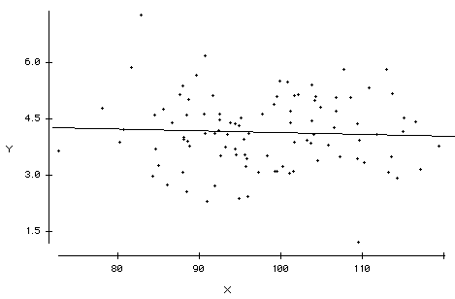
What does a slope of 0 look like?
Example of slope approx. = 0

Slide 16
p-values on output
p<0.001 in the Constant line
Implicitly tests the following null hypothesis
H₀: Population intercept= 0
H₁: Population intercept ≠0
Makes absolutely no sense – we are only interested in diamonds in range of data (0.12 and 0.35 carats)
Funny things might happen outside this range.

Slide 17
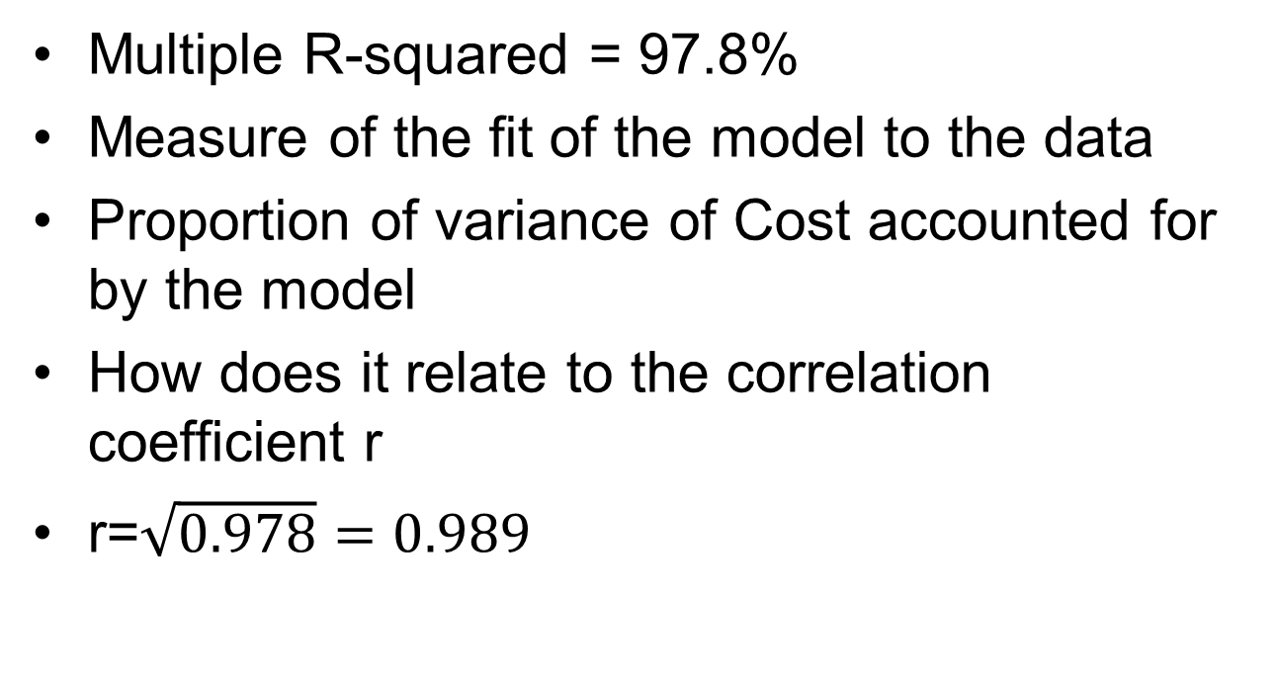
What Multiple R-squared mean?
Multiple R-squared = 97.8%
Measure of the fit of the model to the data
Proportion of variance of Cost accounted for by the model
How does it relate to the correlation coefficient r
r=$\sqrt{0.978}=0.989$

Slide 18
What does s=31.84 measure
For each observation we calculate the residual
s is the standard deviation of the residuals (teeny little difference)
Called residual standard error on R output

Slide 19
Calculation of residuals
Calculate a residual for each case
Resid_{i}=Predicted_{i}-Observed_{i}
Resid_{i}=(-260+3721*Carat_{i})-Observed_{i}
Case 1 Cost = $355 Carat= 0.17
Predicted=-260+3721*0.17=372.57
Resid=372.57-355=17.57

Slide 20
Residuals
We calculate the 48 residuals
Mean of them will be zero
SD approximately equal to Residual standard error on computer output
We need to carry out some checks on the residuals
They should be normally distributed

Slide 21
Be careful
Be very careful in saying what happens outside the range of the data
We do not know what will happen

Slide 22
Summary
Regression is a very powerful technique
We have used a very simple model
Plot data
Run regression
Check residual plots

Slide 23
Classification Tree

